Slide 1
Please silence cell phones

Slide 2
Using Data to Make Decisions
May 7-9, 2014 | San Jose, CA
Dev Nambi, Data Scientist
University of Washington
@DevNambi
me@DevNambi.com

Slide 3

Agenda
Introduction
Decision Engineering
Cars
Houses
Health
Q&A
@DevNambi
me@DevNambi.com

Slide 4

What’s In A Decision

Slide 5

What’s In A Decision

Slide 6

What’s In A Decision
Notes:
http://blog.salemove.com/wp-content/uploads/2013/01/Cost-value.jpg

Slide 7
What’s In A Decision
Problems
Questions
Cost:Value
Goal
Notes:
http://blog.salemove.com/wp-content/uploads/2013/01/Cost-value.jpg

Slide 8
What You Have
Data
Constraints
Time
Brains
The most exciting phrase to hear in science, the one that heralds new discoveries, is not 'Eureka!' but 'That's funny...‘ – Isaac Asimov

Slide 9
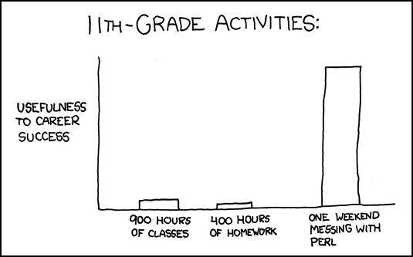
How to Learn
Notes:
http://xkcd.com/519/

Slide 10

Notes:
http://www.cogniview.com/blog/wp-content/uploads/2013/03/Analysis_Paralysis.jpg

Slide 11

The Decision Cycle
Data / Research
Analysis
Questions
10%
80%
Make Decision
10%

Slide 12
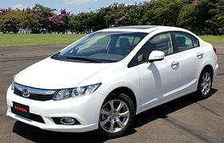
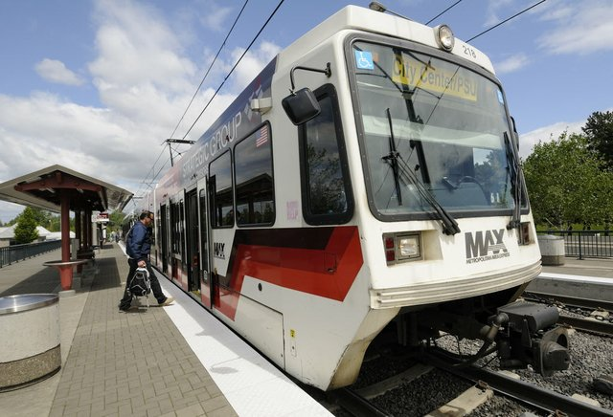

Cars

Slide 13
Constraints
Not Created Equal
They Wear Down
Cost
The Price Drops Faster than Value

Slide 14
Tools
Question
Cost - Total Cost of Ownership
Value – Miles Remaining
Data – Advice, Websites, Reviews
Time - ROI

Slide 15

Demo Time!

Slide 16
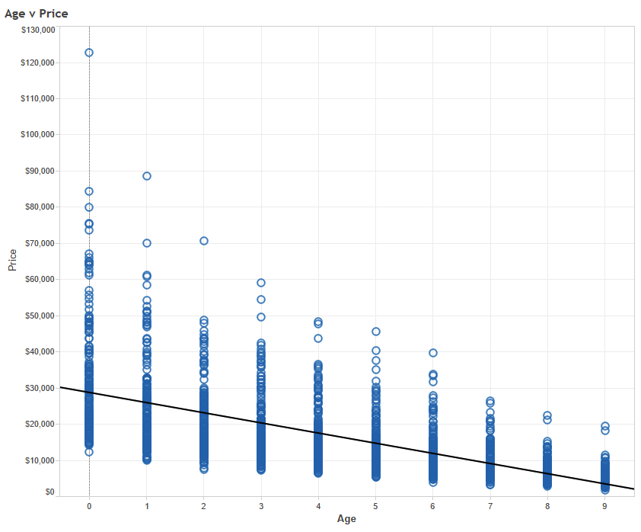

Slide 17
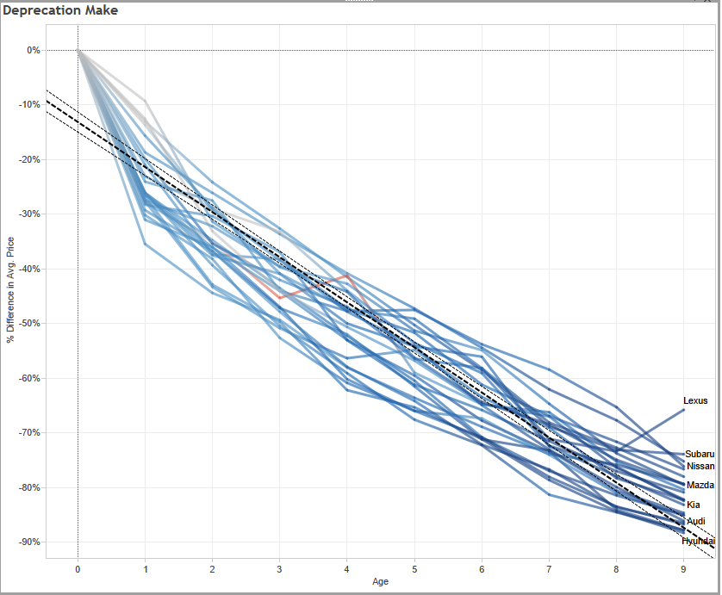

Slide 18
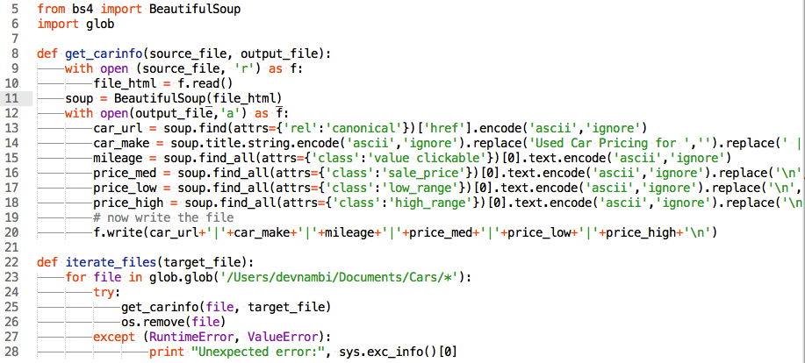
Web Scraping

Slide 19
Demo Time!
Notes:
Useful data sources:
* Use 3Taps to query Craigslist data
* http://vehiclehistory.gov/
* Excel file
* [Craigslist](http://vancouver.en.craigslist.ca/) is the most famous. [AutoTrader](http://www.autotrader.ca/) is another good site.
* Link to Tableau viz
* http://www.insure.com/articles/interactivetools
* http://devnambi.com/2012/buying-a-car-with-data-part-1/
* http://www.theatlantic.com/business/archive/2012/08/smartphones-not-cars-now-mold-youth-culture/260801/
* http://www.reliabilityindex.com/manufacturer

Slide 20
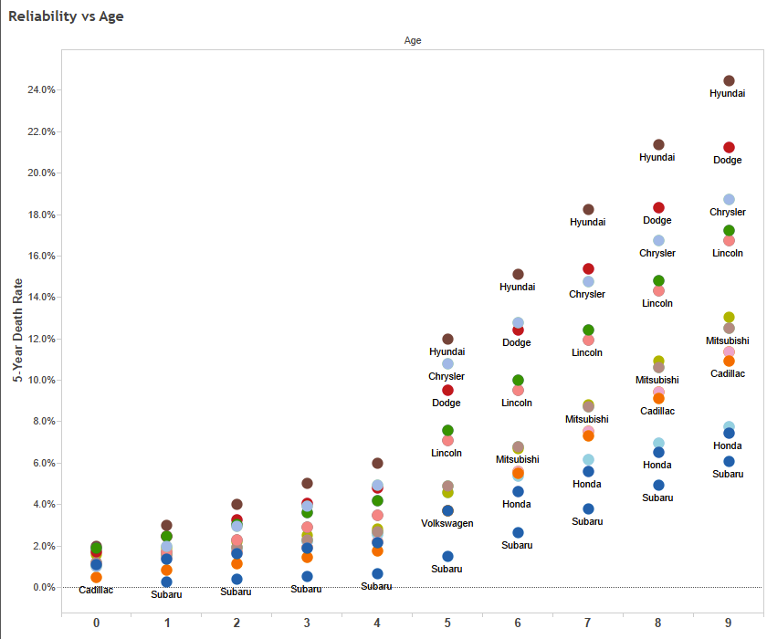

Slide 21
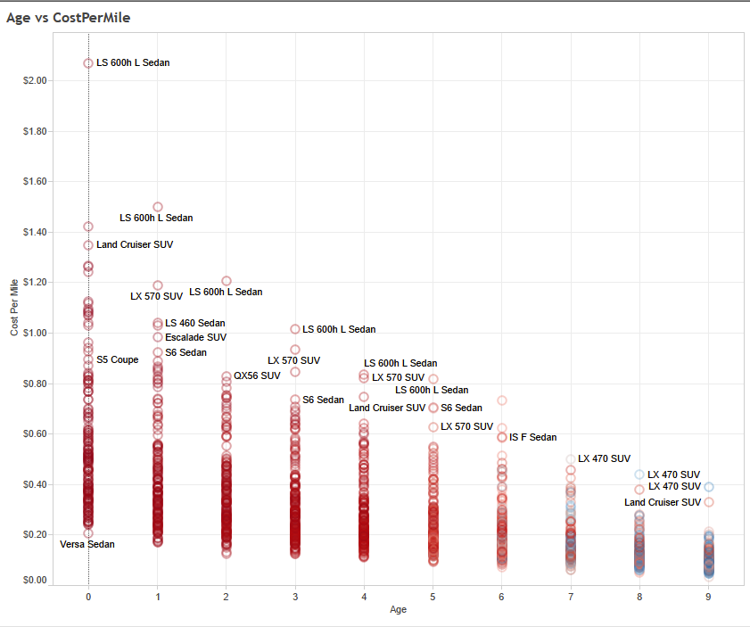

Slide 22
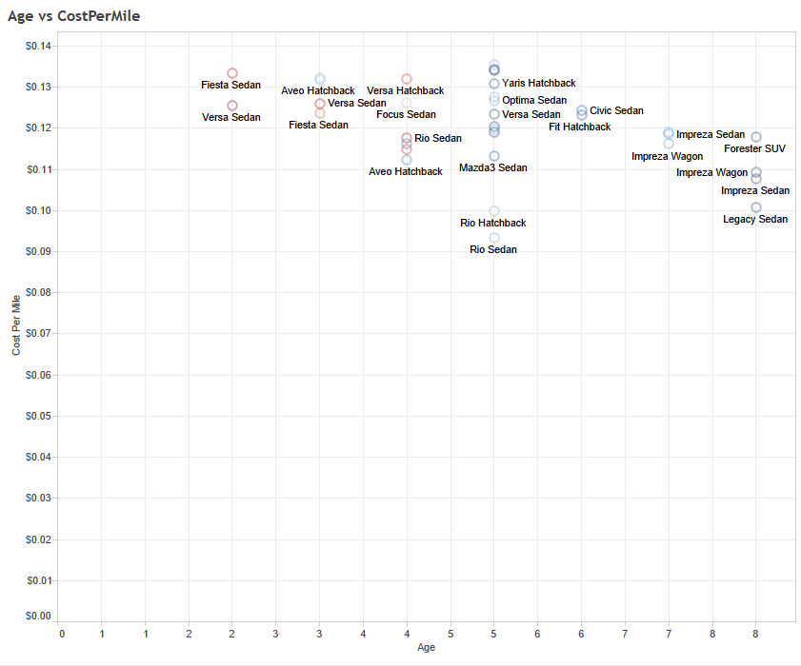

Slide 23
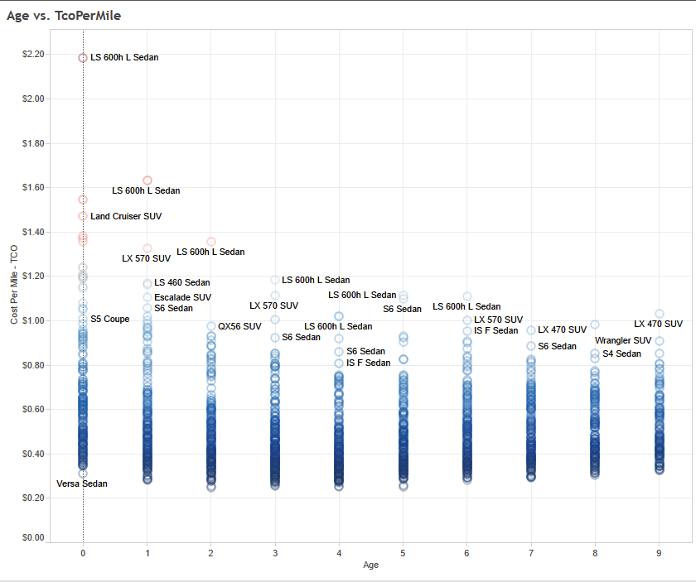

Slide 24
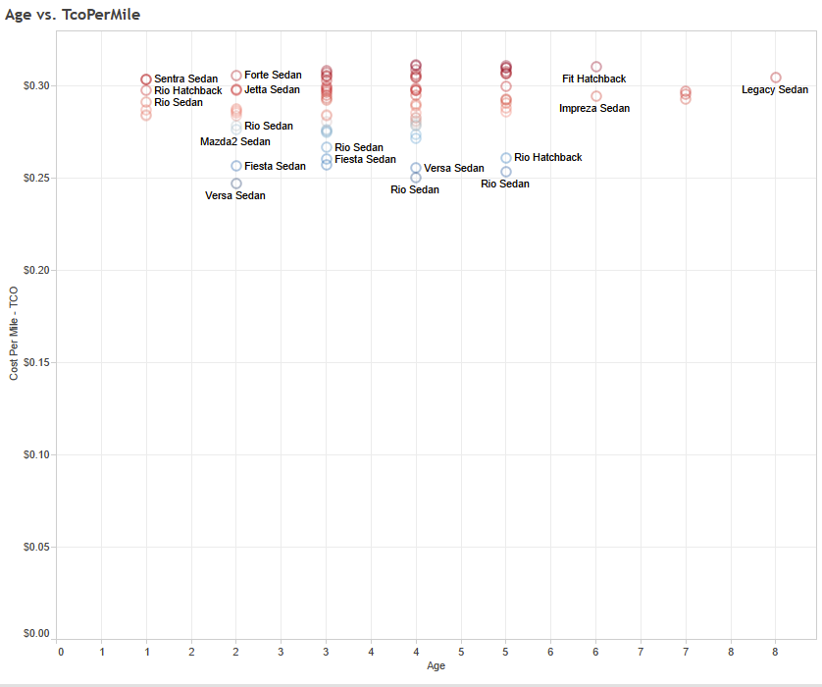

Slide 25

Notes:
(files are from Wikimedia Commons, http://upload.wikimedia.org/wikipedia/commons/4/46/Broken_Down_Old_House_at_Newhouse_-_geograph.org.uk_-_232300.jpg and http://upload.wikimedia.org/wikipedia/commons/thumb/5/55/Highclere_Castle_(April_2011).jpg/1280px-Highclere_Castle_(April_2011).jpg )

Slide 26
Housing
Question
Constraints – Location ~ Schools + Size

Slide 27
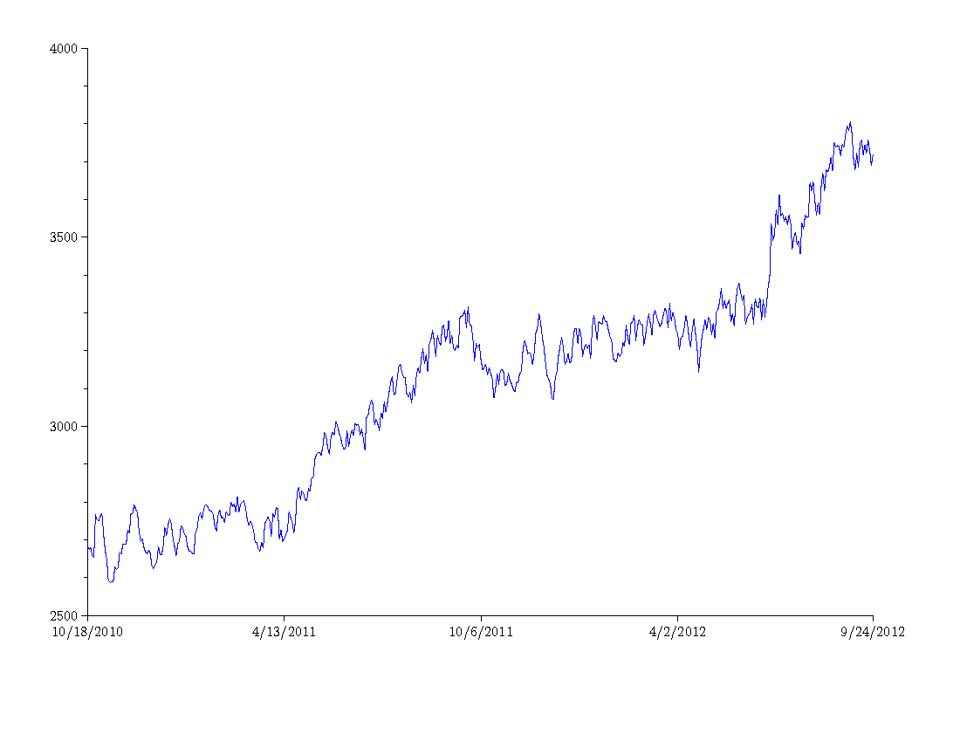
Housing
Notes:
http://gocrashpad.wordpress.com/

Slide 28
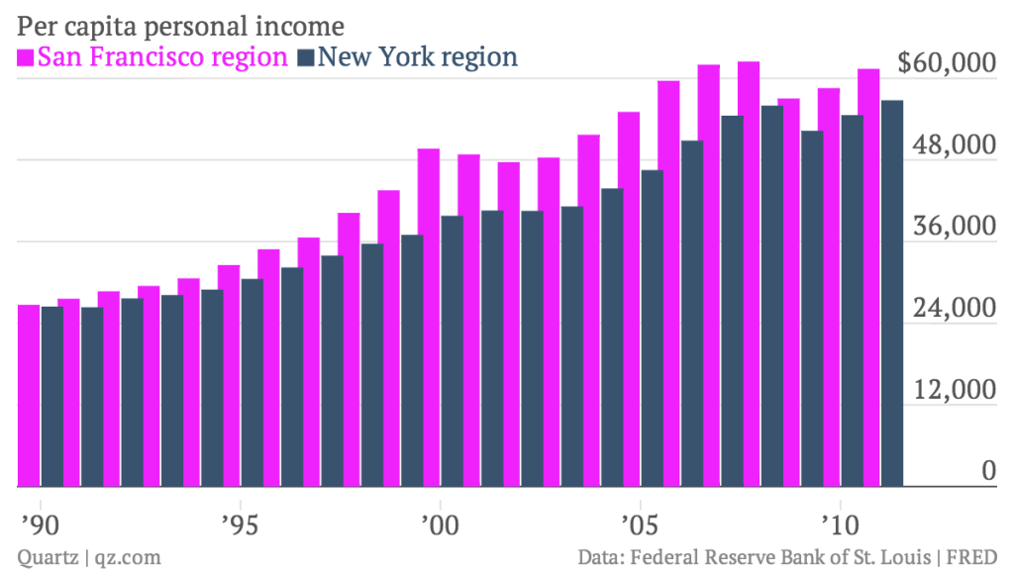
Housing
Notes:
http://qzprod.files.wordpress.com/2013/11/per-capita-personal-income-san-francisco-region-new-york-region_chartbuilder.png?w=1024&h=576

Slide 29
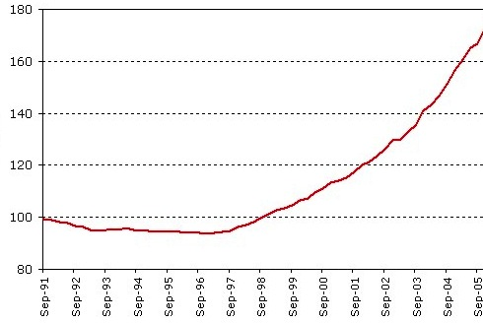
Housing

Slide 30
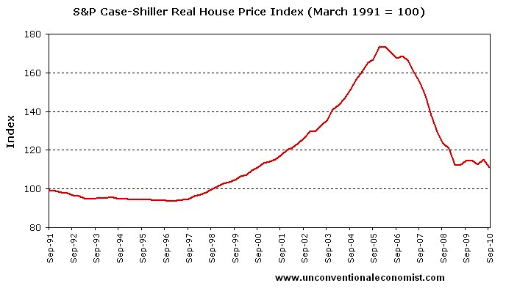
Housing

Slide 31

Notes:
http://intobolivian.files.wordpress.com/2011/08/rent1.jpg

Slide 32
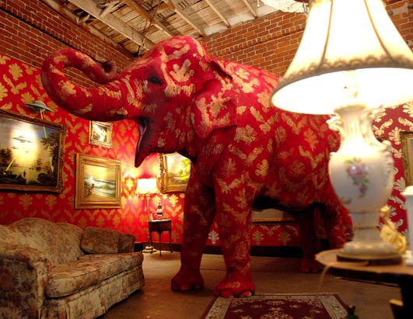
Constraints
Notes:
http://www.calculatedriskblog.com/2012/08/corelogic-house-price-index-increases.html

Slide 33
Housing
Question
Constraints – Location ~ Schools + Size
Cost – Time to Commute + Pay
Value – Quality of Life
Data – Neighborhoods, Prices, Commute
Time – ROI

Slide 34


One Metric to Rule Them All
Notes:
http://en.wikipedia.org/wiki/File:Unico_Anello.png
http://michaelkuttler.deviantart.com/art/Counting-By-Zero-Stopwatch-124538882

Slide 35
Demo Time!
Notes:
* http://www.nytimes.com/2014/04/17/garden/square-feet-84-possessions-305.html?src=me&ref=general
* http://www.economist.com/blogs/freeexchange/2014/04/housing-markets
* http://ansonwhitmer.tumblr.com/post/76570597222/sf-hoods-project
* Matrix prioritization for value
http://www.geekwire.com/2013/app-week-feels-helps-uncertainty-making-tough-decisions/ - An app to help with matrix prioritization

Slide 36
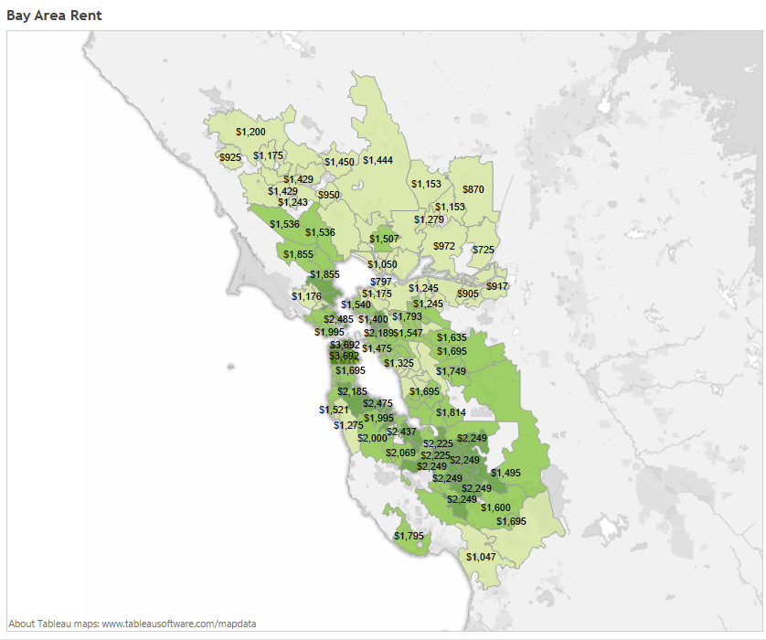

Slide 37
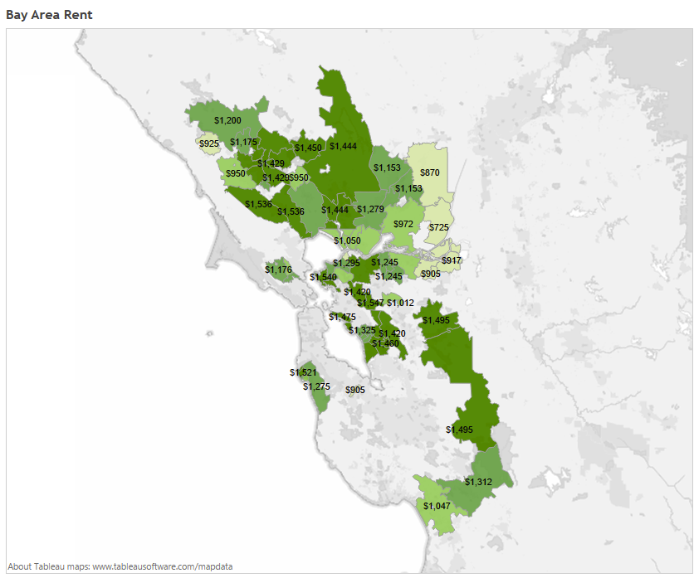

Slide 38
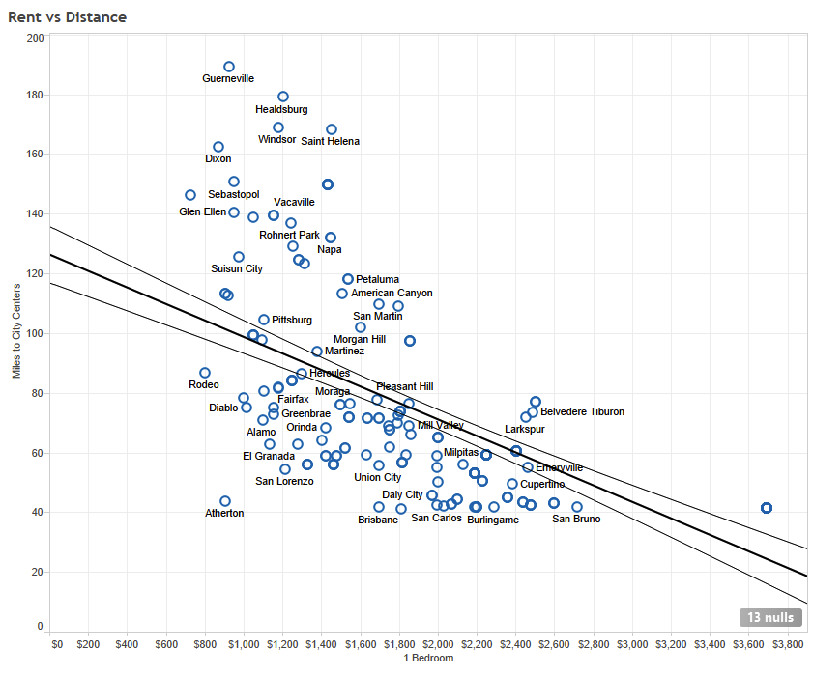

Slide 39
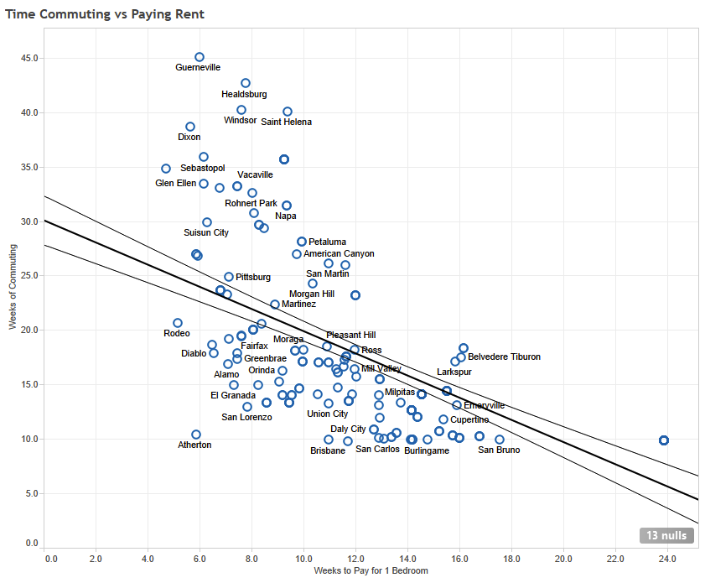

Slide 40
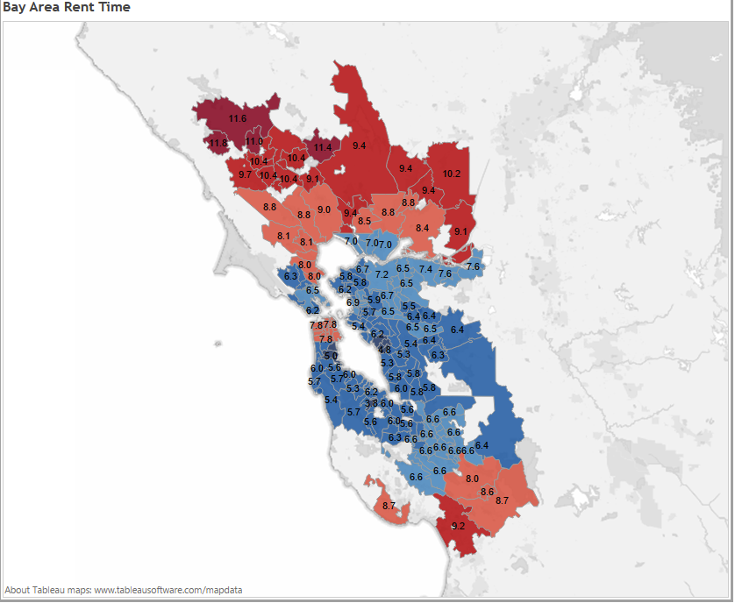

Slide 41
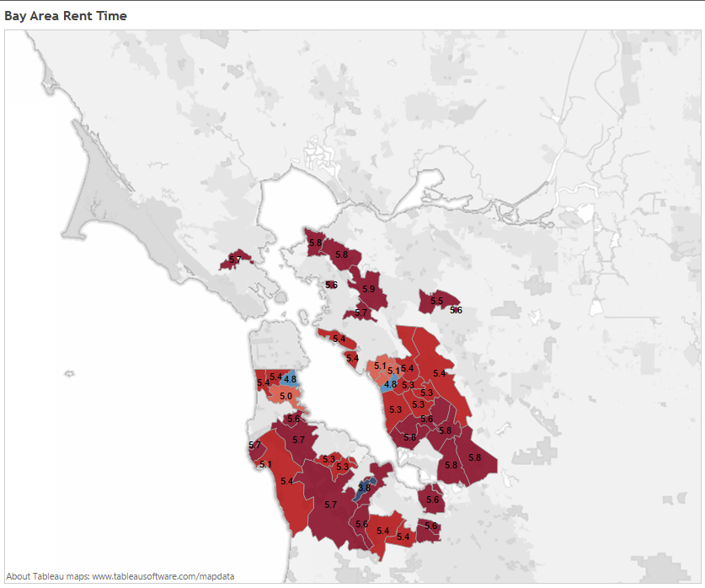

Slide 42

Health Care
Notes:
http://commons.wikimedia.org/wiki/File:Doctor_consults_with_patient_(4).jpg

Slide 43
Constraints

Slide 44
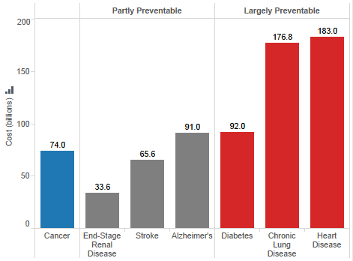
Notes:
http://opinionator.blogs.nytimes.com/2011/04/12/how-to-save-a-trillion-dollars/?_php=true&_type=blogs&_r=0
http://healthcarecostmonitor.thehastingscenter.org/kimberlyswartz/projected-costs-of-chronic-diseases/

Slide 45
The Fastest Code in the World
Notes:
http://en.wikipedia.org/wiki/File:Soy-whey-protein-diet.jpg
http://commons.wikimedia.org/wiki/File:US_Navy_111017-N-ZK021-001_Sailors_conduct_a_group_warm-up_exercise_during_the_Command_Fitness_Leader_(CFL)_course_at_Naval_Air_Station_Whidbey_Isl.jpg

Slide 46
The Cheapest Doctor Visit in the World
Notes:
http://en.wikipedia.org/wiki/File:Soy-whey-protein-diet.jpg
http://commons.wikimedia.org/wiki/File:US_Navy_111017-N-ZK021-001_Sailors_conduct_a_group_warm-up_exercise_during_the_Command_Fitness_Leader_(CFL)_course_at_Naval_Air_Station_Whidbey_Isl.jpg

Slide 47

Notes:
http://memegenerator.net

Slide 48


The ROI of Healthy Living
Notes:
http://en.wikipedia.org/wiki/File:Soy-whey-protein-diet.jpg
http://commons.wikimedia.org/wiki/File:US_Navy_111017-N-ZK021-001_Sailors_conduct_a_group_warm-up_exercise_during_the_Command_Fitness_Leader_(CFL)_course_at_Naval_Air_Station_Whidbey_Isl.jpg

Slide 49
Demo Time!
Notes:
http://devnambi.com/2014/exercise/

Slide 50
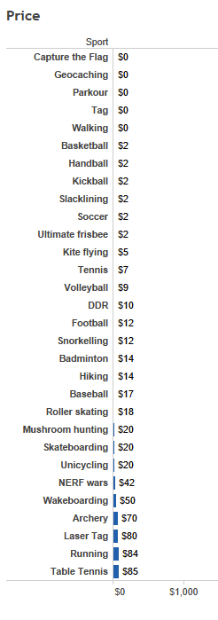
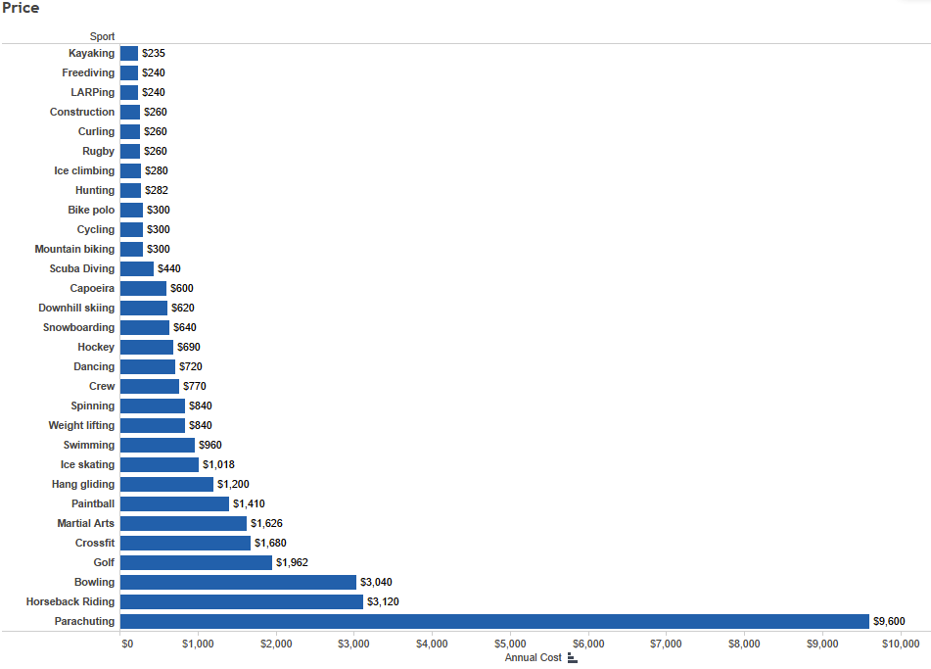

Slide 51
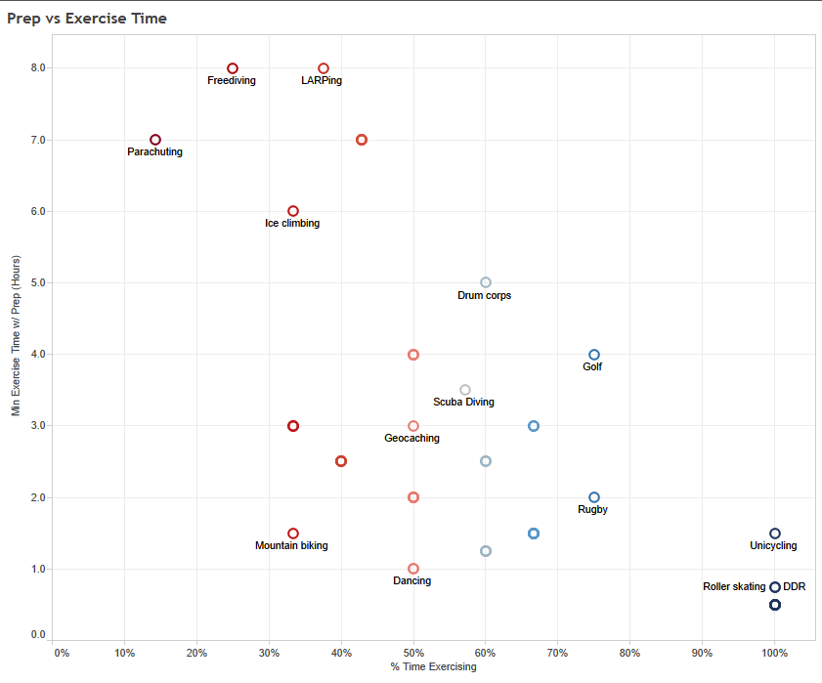

Slide 52
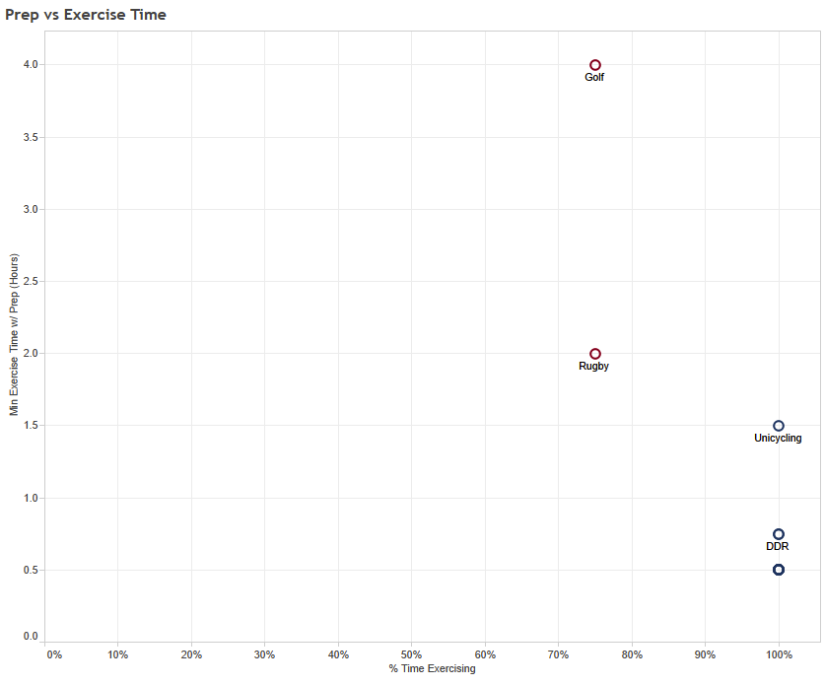

Slide 53
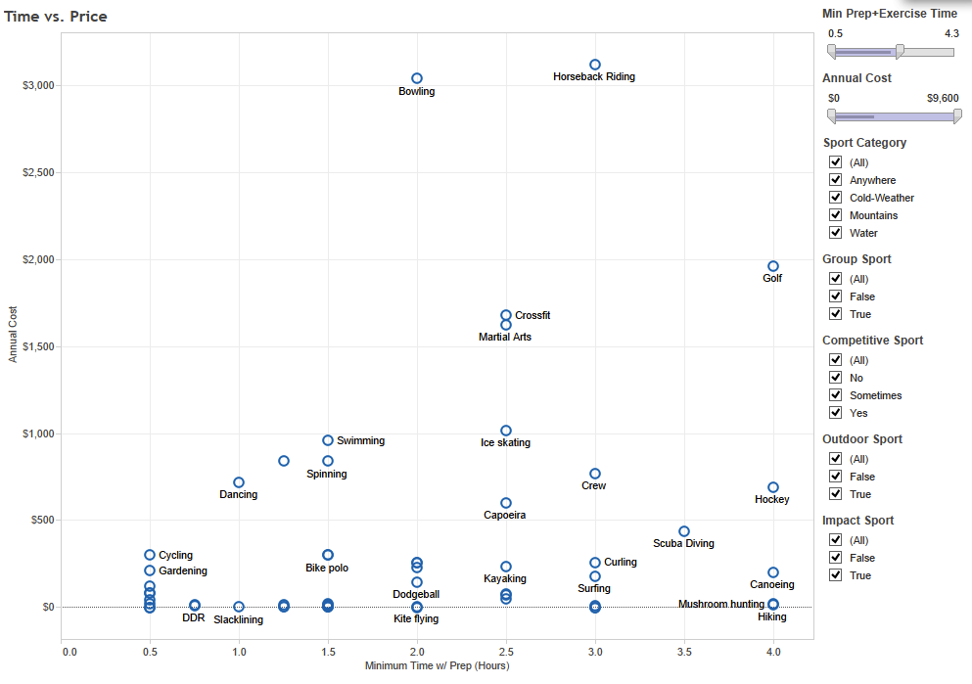

Slide 54
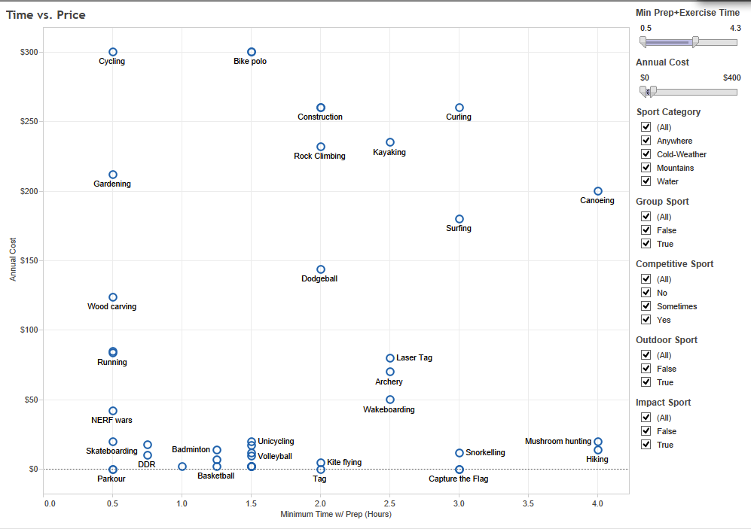

Slide 55
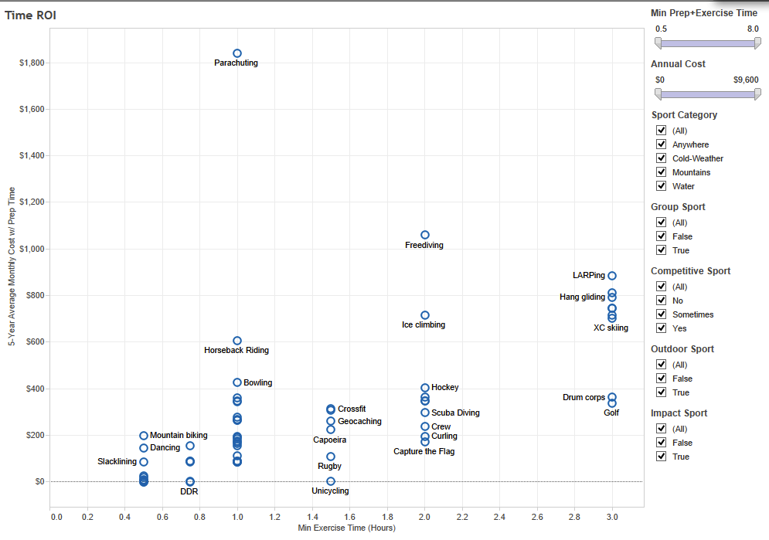

Slide 56
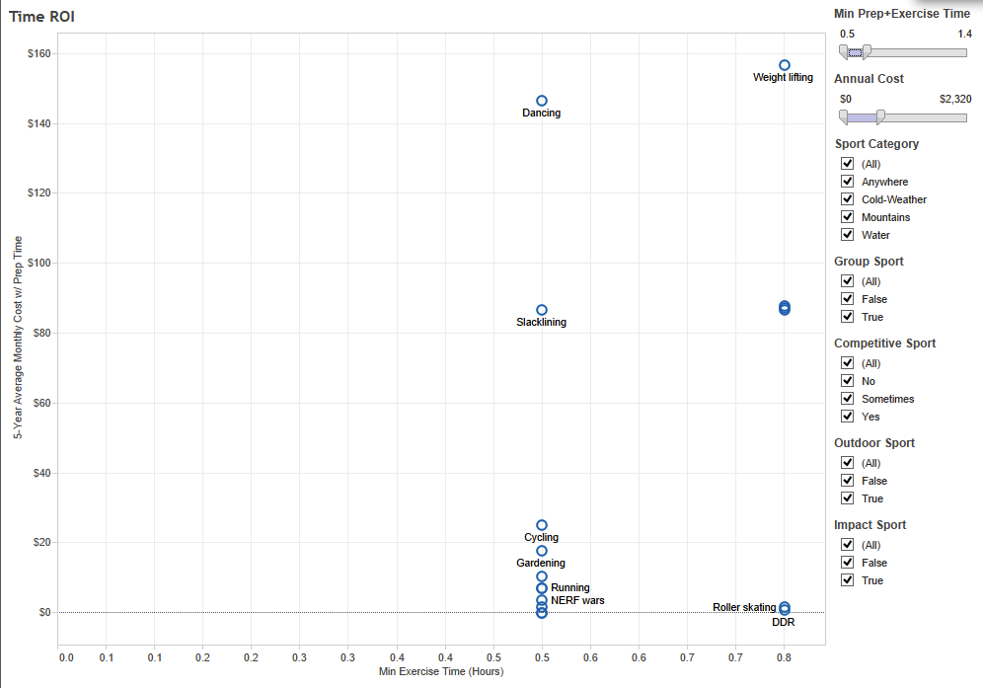

Slide 57
Resources
http://devnambi.com/
https://github.com/DevNambi/DataScienceLearning/

Slide 58
Q & A
?

Slide 59

Session Evaluations
ways to access
Your feedback is important and valuable.
Submit by 5pm Friday May 9 to WIN prizes
Go to passbac2014/evals
Download the PASS EVENT App from your App Store and search: PASS BAC 2014
Follow the QR code link displayed on session signage throughout the conference venue and in the program guide

Slide 60



May 7-9, 2014 | San Jose, CA
Thank
You
for attending this session and the PASS Business Analytics Conference 2014

